Slide 1
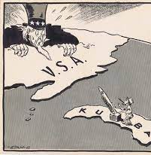
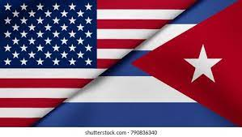
The Cold War
In
Cuba

Slide 2
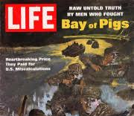
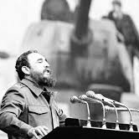
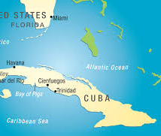
Bay of Pigs Invasion
The Bay of Pigs Invasion - April 17-19, 1961 an unsuccessful attempt by US-backed Cuban exiles to overthrow the government of the Cuban dictator Fidel Castro
Increasing friction between the US and Castro's communist regime led President Eisenhower to break off diplomatic relations with Cuba in January 1961.
The invasion plan was approved by Eisenhower's successor, John F. Kennedy.
The plan failed and left Kennedy & the CIA humiliated

Slide 3
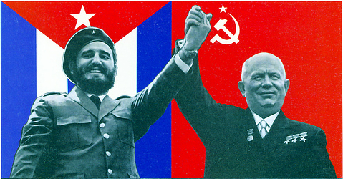

Tension Continues
The Soviet premier, Nikita Khrushchev, capitalized on the failed invasion, allied with Castro, and secured from Castro the right to place nuclear missiles in Cuba.

Slide 4
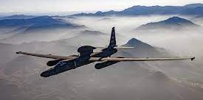
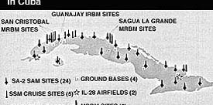
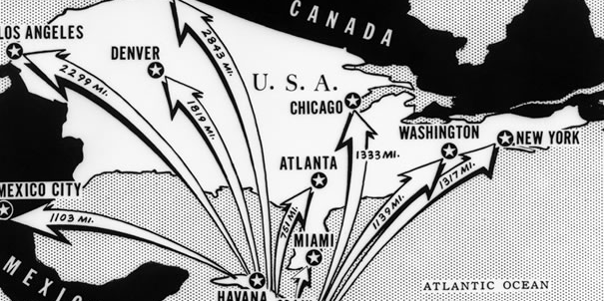
Cuban Missile Crisis
The US heard rumors that the Russians were placing missiles in Cuba.
Kennedy sent U2 spy planes to investigate. The took photos which proved that the rumors were true.
Khrushchev & Castro said threat the missiles were there as protection in case the US invaded again.
However, from where they were located, these missiles could fire at almost any major US city.

Slide 5
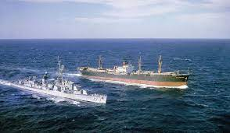
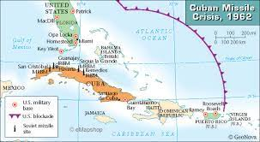
Cuban Missile Crisis
Kennedy ordered a naval blockade of Cuba: meaning that all ships heading toward Cuba would be stopped & searched.
This was a risk as there was no guarantee that the Russians would obey.
On Oct 28th Soviet Ships were only 30 minutes away from the blockade line.
Just when conflict seemed inevitable, Khrushchev ordered the ships to turn back thus avoiding certain war. This was a major victory for Kennedy.

Slide 6
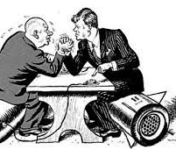
The Agreement
After exchange of messages, Kennedy & Khrushchev reached a confidential agreement:
• US will remove IRBMs from Turkey, Italy
• USSR will remove missiles from Cuba
• US pledged not to invade Cuba
• USSR agreed not to publicly reveal removal of IRBMs

